Slide 1
Forest Sound-Track
City Forest Visitors’ Challenge
MakeZurich Vol.II
Oleg and Afsoon
And thanks to Baxter and Tillo

Slide 2
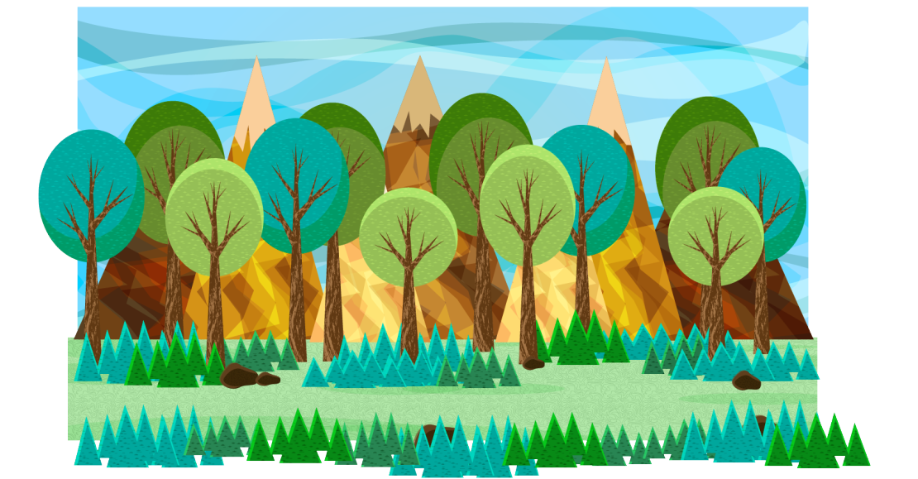
Approach:
Sound Measurement & Machine Learning
Goal:
Count/ Identify/ Classify/ Trace

Slide 3
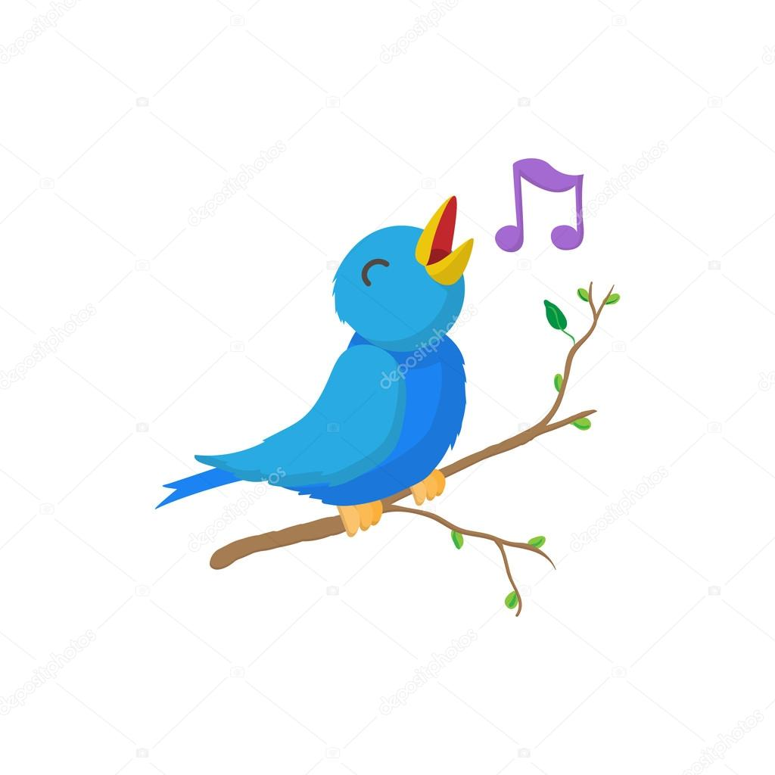

Use Cases:
Schools/Research
Parks and Openspace planning
Bird Watchers
etc

Slide 4

Training Dataset:
Crowd sourced Data :
Xeno-Canto
Feedforward Neural Network

Slide 5



Slide 6

Alert to user’s device
Which bird?
Where?
When?

Slide 7
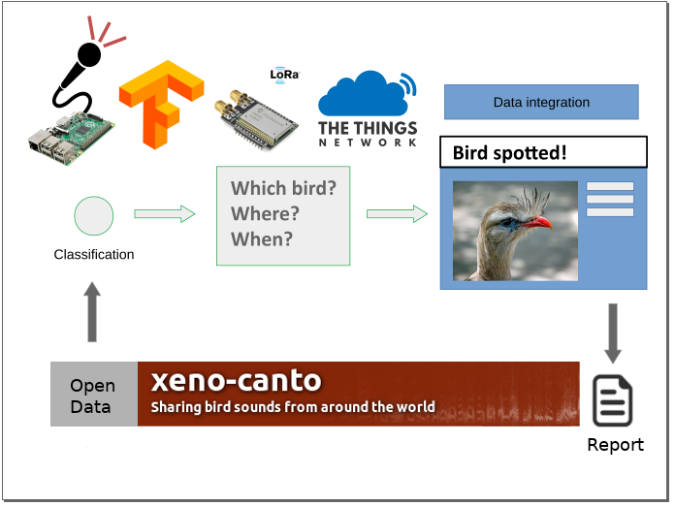
Forest Sound-Track
Oleg Lavrovsky, Afsoon Ebrahimi

